Slide 1
Project Tools- Relevant To Fresher’s Scope of work

Slide 2
What to Expect from the session
After the session there will be clear understanding of below mentioned topics
Source Code Version – SVN
TeamForge
Ticketing Tool
Other Tools & Accelerators

Slide 3
Overview of Project Tools Used
Capgemini has proprietary tools & accelerators to increase productivity, predictability and reduce costs.

Slide 4

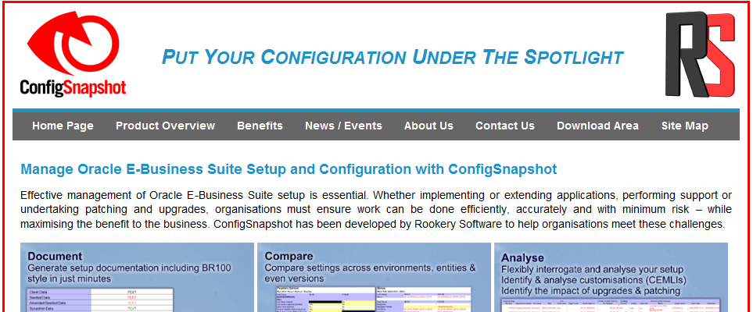
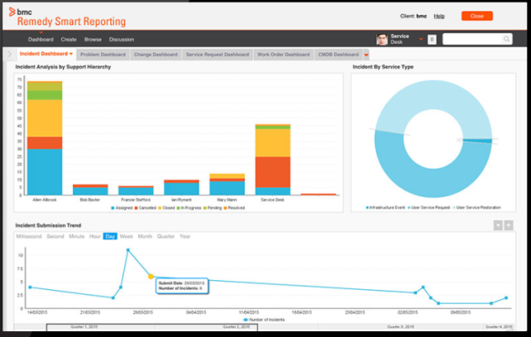
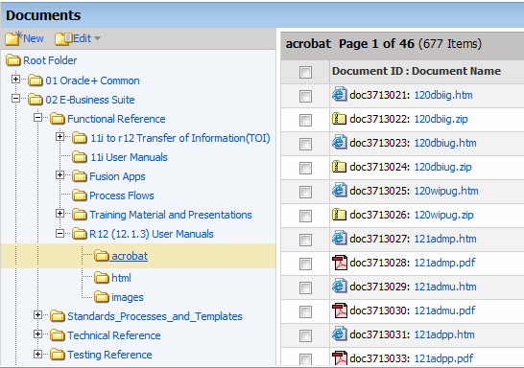
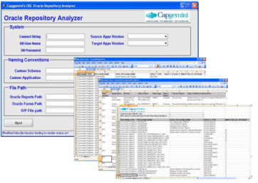
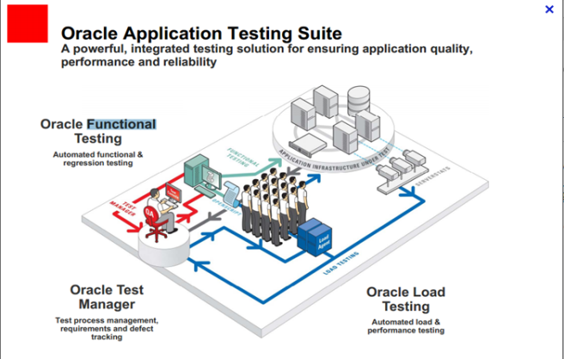
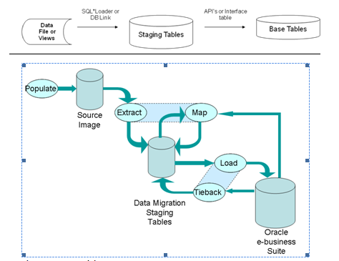
Tools and Accelerator
Config Snapshot
Ticketing Tool - Remedy
Knowledge Repository – Team forge
Custom Spot lighter
Data Migration Toolkit
OATS

Slide 5


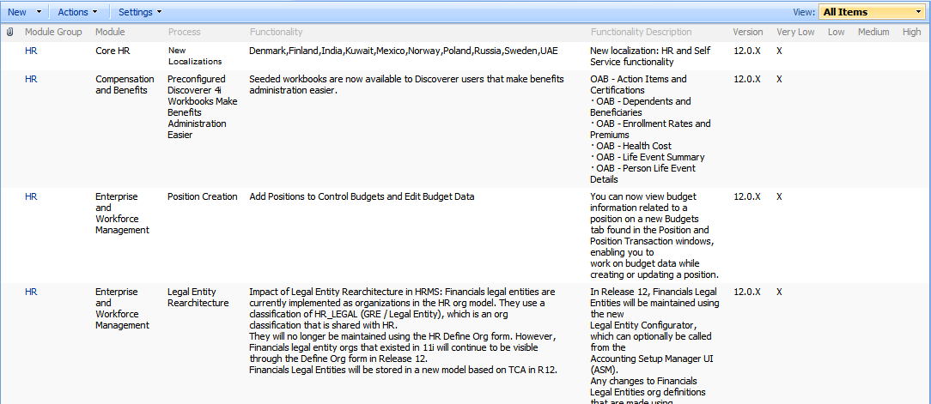
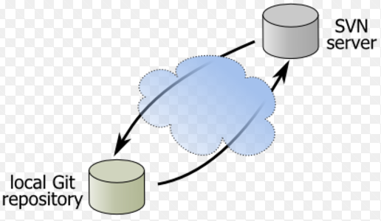
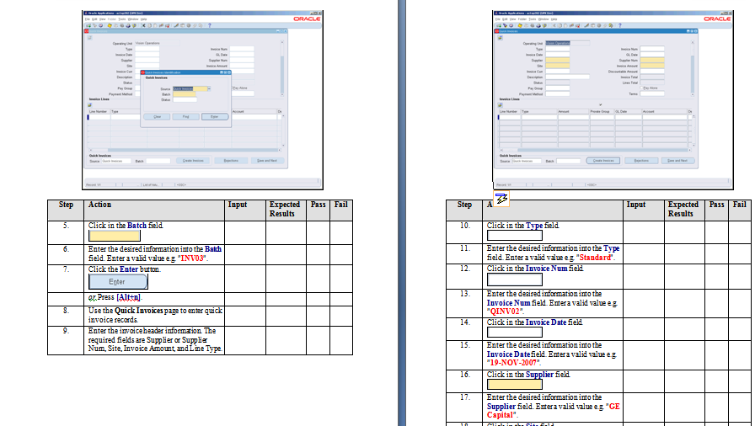
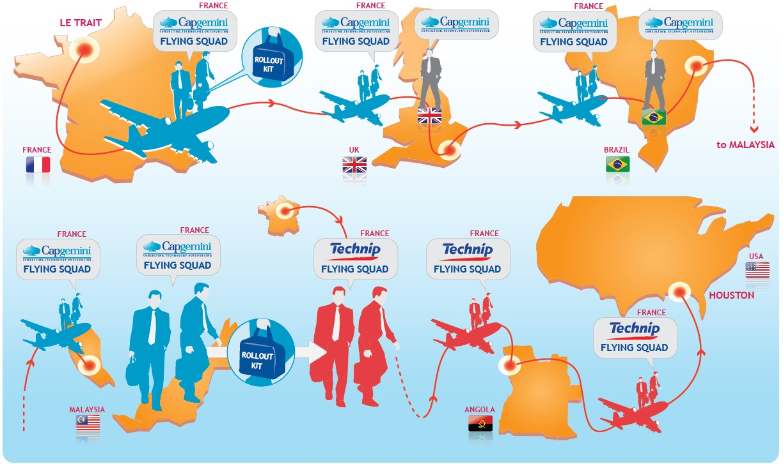
Tools and Accelerator
Clarity
Functional Impact Matrix
Version Control Tool
Testing Toolkit
Country Localization Kit
Global Rollout Kit

Slide 6
Questions and Answers

